Slide 1
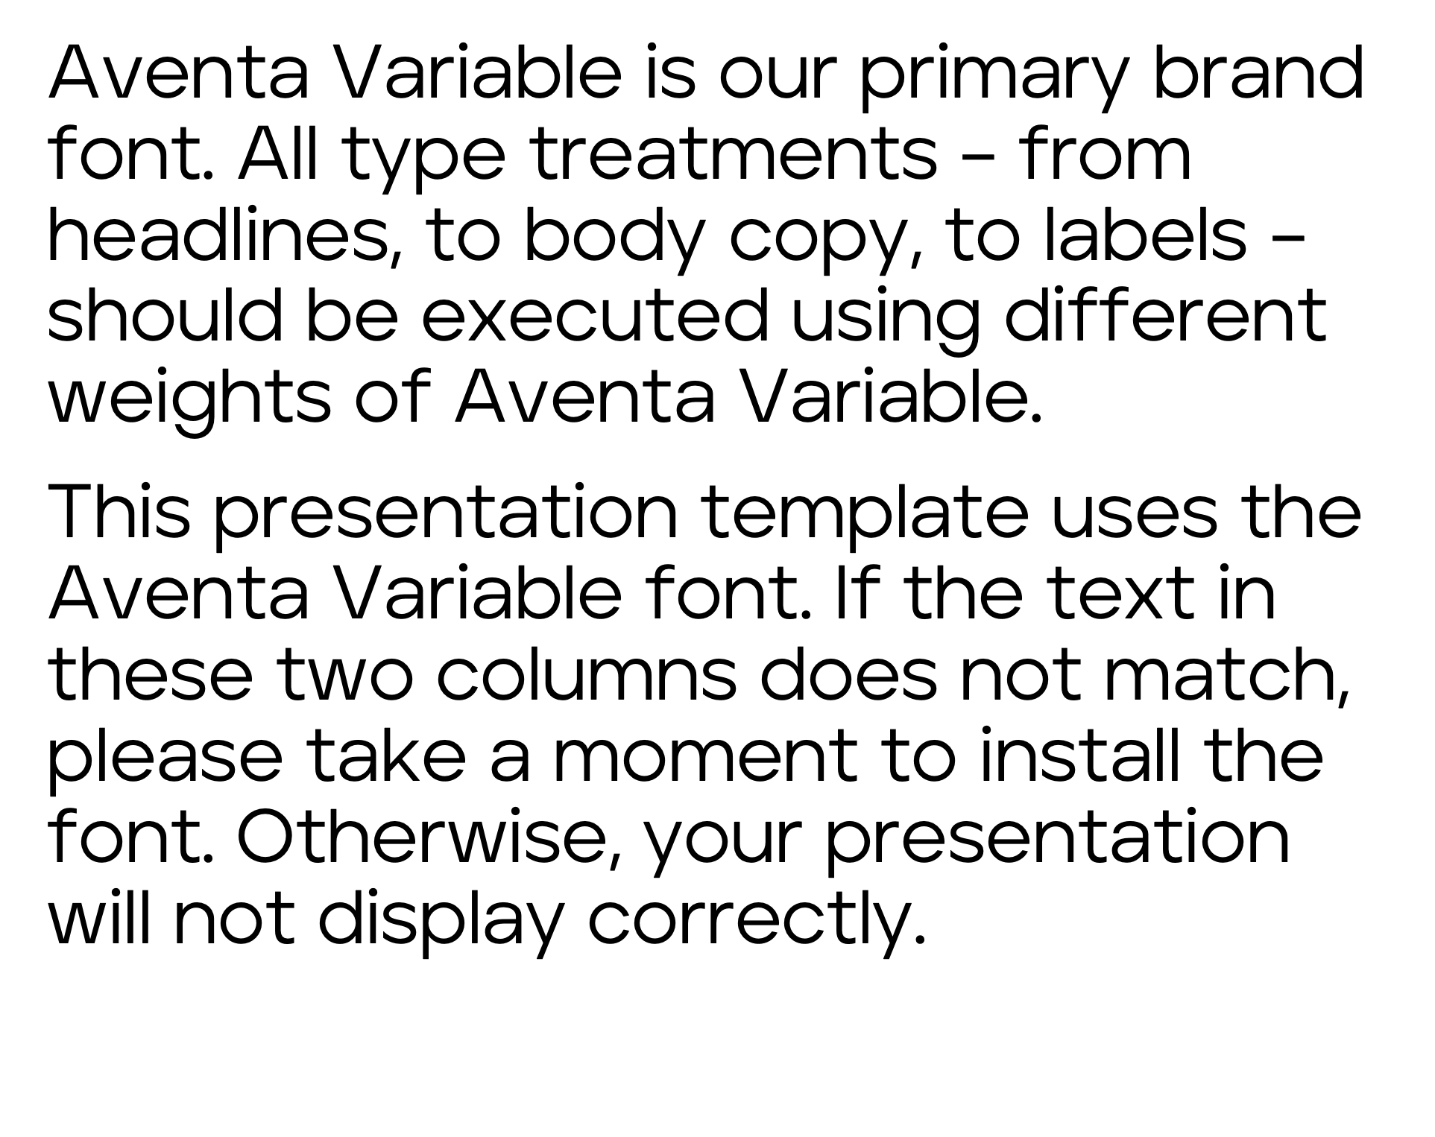
Please Read
Aventa Variable is our primary brand font. All type treatments – from headlines, to body copy, to labels – should be executed using different weights of Aventa Variable.
This presentation template uses the Aventa Variable font. If the text in these two columns does not match, please take a moment to install the font. Otherwise, your presentation will not display correctly.

Slide 2
Title goes here Aventa, 34 pt
Aventa, 24 pt, three lines

Slide 3
Title goes here Aventa, 38 pt
Aventa, 24 pt, three lines

Slide 4
Title goes here Aventa, 34 pt
Aventa, 24 pt, three lines

Slide 5
Title goes here Aventa, 34 pt
Aventa, 24 pt, three lines

Slide 6
Title w/image Aventa, 34 pt
Aventa, 24 pt, three lines

Slide 7
Title w/image Aventa, 34 pt
Aventa, 24 pt, three lines

Slide 8
Title w/image Aventa, 34 pt
Aventa, 24 pt, three lines

Slide 9
Header – Aventa, 30 pt, two lines Content slide 1
Aventa, 28 pt
24 pt
20 pt
20 pt
20 pt

Slide 10
Header – Aventa, 30 pt, two lines Content slide 2
Aventa, 28 pt
24 pt
20 pt
20 pt
20 pt

Slide 11
Header – Aventa, 30 pt, two lines Content slide 3
Aventa, 28 pt
24 pt
20 pt
20 pt
20 pt

Slide 12
Header – Aventa, 30 pt, two lines Content w/slash slide 1
Aventa, 28 pt
24 pt
20pt
20 pt
20 pt

Slide 13
Header – Aventa, 30 pt, two lines Content w/slash slide 2
Aventa, 28 pt
24 pt
20pt
20 pt
20 pt

Slide 14
Header – Aventa, 30 pt, two lines Content w/slash slide 3
Aventa, 28 pt
24 pt
20pt
20 pt
20 pt

Slide 15
Large Divider Aventa, 46 pt, three lines Section slide 1
Aventa, 24 pt, three lines

Slide 16
Large Divider Aventa, 46 pt, three lines Section slide 2
Aventa, 24 pt, three lines

Slide 17
Large Divider Aventa, 46 pt, three lines Section slide 3
Aventa, 24 pt, three lines

Slide 18
Aventa, 32 pt, Divider page

Slide 19
Aventa, 32 pt Divider page
Aventa, 24 pt, three lines three linesAventa, 24 pt, three lines

Slide 20
Aventa, 30 pt, two lines Two-column slide
Aventa, 26 pt
22 pt
20 pt
20 pt
20 pt
Aventa, 26 pt
22 pt
20 pt
20 pt
20 pt

Slide 21
Aventa, 30 pt, two lines Comparison slide
Aventa, 24 pt, two lines
Aventa, 24 pt, two lines
Aventa, 26 pt
24 pt
20 pt
20 pt
20 pt
Aventa, 26 pt
24 pt
20 pt
20 pt
20 pt

Slide 22


Content w/image Aventa, 30 pt, two lines
Aventa, 20 pt

Slide 23

Content w/image Aventa, 30 pt, two lines
Aventa, 20 pt

Slide 24

Content w/image Aventa, 30 pt, two lines
Aventa, 20 pt

Slide 25

Content w/image Aventa, 30 pt, two lines
Aventa, 20 pt

Slide 26
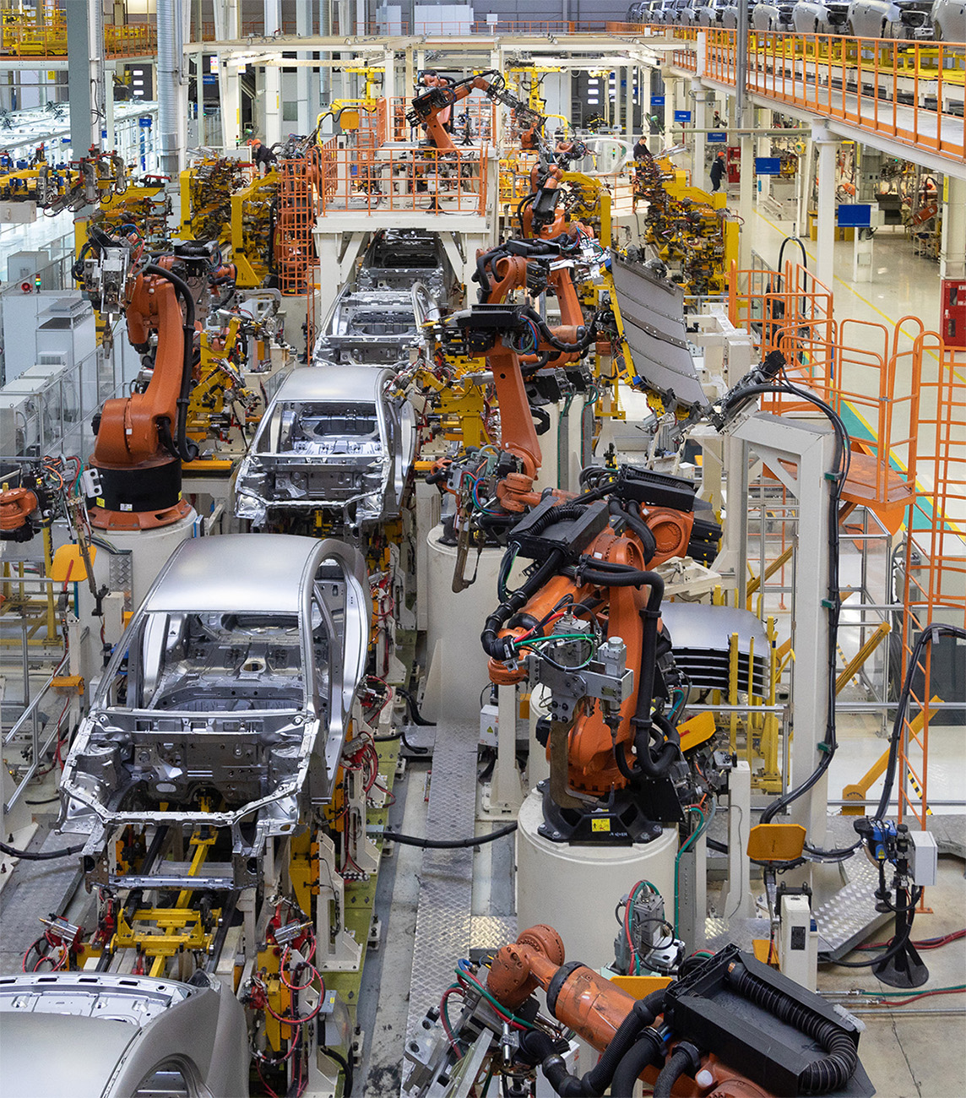
Content w/image Aventa, 30 pt, two lines
Aventa, 20 pt

Slide 27
Aventa, 30 pt, two lines Free slide

Slide 28
Aventa, 46 pt, six lines Statement slide

Slide 29
Aventa, 40 pt, six lines Quote slide
“The spectacle before us was indeed sublime.
Apparently, we had reached a great height in the atmosphere, for the sky was a dead black, and the stars had ceased to twinkle.
Looking down into the dark gulf below, I could see a ruddy light streaming through a rift in the clouds.”
– Name

Slide 30

Plug and Play
Ctrl C + Ctrl V
The quick brown fox
The quick brown fox
200
Body Line One
Body Line Two
Body Line Three
Body Line One
Body Line Two
Body Line Three
Days
1
Body Line One
Body Line Two
Body Line Three
The quick brown fox
Body Line One
Body Line Two
Body Line Three
Body Line One
Body Line Two
Body Line Three
The fox

Slide 31
The quick brown fox jumps over the lazy dog
The quick brown fox | The quick brown fox | The quick brown fox
A red flare silhouetted the jagged edge of a wing. Looking down into the dark gulf below, I could see a ruddy light streaming through a rift in the clouds. | A red flare silhouetted the jagged edge of a wing. Looking down into the dark gulf below, I could see a ruddy light streaming through a rift in the clouds. | A red flare silhouetted the jagged edge of a wing. Looking down into the dark gulf below, I could see a ruddy light streaming through a rift in the clouds.
The quick brown fox | The quick brown fox | The quick brown fox
A red flare silhouetted the jagged edge of a wing. | A red flare silhouetted the jagged edge of a wing. | A red flare silhouetted the jagged edge of a wing.

Slide 32
The quick brown fox jumps over the lazy dog
The quick brown fox jumps over the lazy dog | Text | Text | Highlight | Text
A red flare silhouetted the jagged edge of a wing. |  |  | Highlight
I watched the storm, so beautiful yet terrific.
Almost before we knew it, we had left the ground. |  |  | Highlight
The quick brown fox jumps over the lazy dog

Slide 33
The quick brown fox jumps over the lazy dog
The quick brown fox jumps over the lazy dog | Text | Text | Highlight | Text
A red flare silhouetted the jagged edge of a wing. |  |  | Highlight
I watched the storm, so beautiful yet terrific.
Almost before we knew it, we had left the ground. |  |  | Highlight

Slide 34
The quick brown fox jumps over the lazy dog
A red flare silhouetted the jagged edge of a wing.
The spectacle before us was indeed sublime.
Apparently we had reached a great height in the atmosphere, for the sky was a dead black, and the stars had ceased to twinkle.
Looking down into the dark gulf below, I could see a ruddy light streaming through a rift in the clouds.
Did the quick brown fox jump over the lazy dog?

Slide 35
The quick brown fox jumps over the lazy dog
A red flare silhouetted the jagged edge of a wing.
Strengths
Weaknesses
The spectacle before us was indeed sublime.
Apparently, we had reached a great height in the atmosphere, for the sky was a dead black, and the stars had ceased to twinkle.
Looking down into the dark gulf below, I could see a ruddy light streaming through a rift in the clouds.
S
W
O
T
Opportunities
Threats

Slide 36
The quick brown fox jumps over the lazy dog
The quick brown fox jumps over the lazy dog
The quick brown fox jumps over the lazy dog
The quick brown fox jumps over the lazy dog
A red flare silhouetted the jagged edge of a wing.
A red flare silhouetted the jagged edge of a wing.
A red flare silhouetted the jagged edge of a wing.
I watched the storm, so beautiful yet terrific.
I watched the storm, so beautiful yet terrific.
I watched the storm, so beautiful yet terrific.
I watched the storm, so beautiful yet terrific.
I watched the storm, so beautiful yet terrific.
I watched the storm, so beautiful yet terrific.
Almost before we knew it, we had left the ground.
The quick brown fox jumps over the lazy dog
The quick brown fox jumps over the lazy dog

Slide 37
The quick brown fox jumps over the lazy dog
The Quick Fox
The Quick Fox
A Red Flare
The Quick Fox
The Spectacle
The Quick Fox
The Quick Fox
The Fox
The Quick Fox
A Red Flare
The Quick Fox
The Spectacle
The Quick Fox
The Quick Fox
The Quick Fox
The Quick Fox
A Red Flare
Jan
Feb
Mar
Apr
May
Jun
Jul

Slide 38
The quick brown fox jumps over the lazy dog
A red flare silhouetted the jagged edge of a wing.
70%
Text
The spectacle before us was indeed sublime.
Apparently, we had reached a great height in the atmosphere, for the sky was a dead black, and the stars had ceased to twinkle.
Section 1 | Section 2 | Section 3 | Section 4

Slide 39
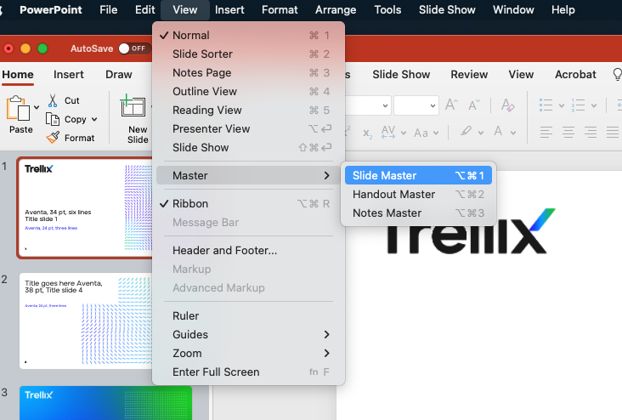
Master Slides
When to view and edit them
Change the content classification across the presentation
Copy and edit Plug and Play elements
Section 1 | Section 2 | Section 3 | Section 4

Slide 40
Content Classification
Category | What Information
Trellix Restricted | Information that is most sensitive, private and of highest value to Trellix. Includes trade secrets; financial data, including results prior to release; source code and product development.
Trellix Internal Use Only | Confidential information that is available only to employees. Includes merger/acquisition-related data; Trellix organization charts; telephone directories; Outlook Global Address List; and IT data such as IP addresses and network diagrams, digital certificate private keys; PINs; and control implementation; audit reports and findings.
Trellix Confidential | Information that is sensitive or confidential and intended for business use only by those with a need-to-know. Includes Personally Identifiable Information (PII); customer, client, or vendor information (including communications and contact lists, and financial dealings); credit card numbers, attorney-client privileged data; cost or pricing data; strategic plans, marketing plans, corporate policies; corporate stationary; employee records.
External Facing / Public | Non-sensitive data specifically approved for public disclosure and distribution. All marketing related communications must be approved by Trellix Marketing and Legal (as appropriate) prior to publication.

Slide 41
Text
TEXT
Value Axis

Slide 43
Flow
1
2
3
4
1
2
70%
3
70%
70%

Slide 44
World
Body Left Align
Body Left Align
Body Left Align

Slide 45
World
Body Left Align
Body Left Align
Body Left Align

Slide 46
United States
Body Left Align
Body Left Align
6
2
Body Left Align
1
Body Left Align
3
4
Body Left Align
5
Body Left Align
* Copy from master slide to normal slide to edit

Slide 47
Color Palettes
Brand
Grays
#
2814FF
00A5FF
00CD00
#
1A1A1A
4D4D4D
EBEBEB
Where possible, please try to arrange colors in the following order:
Functional
Color Palette
#
00A5FF
EBC80A
00CD00
FA9600
A537B4
CD2364

Slide 48

LIVING SECURITY XDR ECOSYSTEM
ENDPOINTS
CLOUD
APPLICATIONS
INFRASTRUCTURE
COLLABORATION
DATA & USERS

Slide 49
Icons

Slide 50
Icons

Slide 51
Thank you

